Slide 1



Start
Milestone
Begin journey with clear goals
Celebrate major achievements reached
Checkpoint
Finish
Review progress and adjust plan
Reach destination and reflect
MedConnect – Digital Medical Education Workflow System
Making Kothagudem Telangana's First Fully Digital Medical Campus
TechM4India – TechM4Solutions DivisionPresented to: Directorate of Medical Education, Telangana

Slide 2

Executive Summary
MedConnect is a unified digital medical campus ecosystem that modernizes academic, clinical, administrative, and governance workflows.
Academic Digitization
Clinical Digitization
Campus Administration
NMC-aligned learning modules
Digital logbooks
Digital certificates
AI-powered instruction
Posting & duty automation
Hostel management
3D curriculum tools
Attendance & finance
Free 1-month pilot at a Govt Medical CollegeNo cost or infrastructure burden to DME

Slide 3

Vision
Transform GMC Kothagudem into Telangana's first fully digital medical campus
Create a replicable statewide digital model
Enable real-time academic, administrative & governance visibility
Build future-ready NMC-aligned digital infrastructure

Slide 4
Mission
AI-Powered Learning
1
Deliver competency-based medical education with artificial intelligence
2
Automation
Reduce faculty & admin workload through intelligent automation
Transparency
3
Provide real-time dashboards for DME leadership visibility
4
Digital Lifecycle
Enable complete digital student journey from admission to graduation
Scalability
5
Scale across all DME medical colleges statewide

Slide 5
Problem Statement
No centralized student academic data
Manual clinical logbooks → inconsistent + unverified
Limited digital tools for medical learning
Paper-based postings, attendance & hostel workflows
No real-time visibility for Principal / DME
No AI insights for academics or governance
Students use multiple disconnected apps

Slide 6

Core Modules & Descriptions
📚 Pillar 1 — Student Learning
🧑‍🏫 Pillar 2 — Faculty Tools
Structured curriculum
Content upload
3D simulations
Topic allocation
AI academic instructor
Student progress monitoring
Weekly analytics & reminders
🏫 Pillar 3 — Digital Campus
🏥 Pillar 4 — Clinical Integration
QR+GPS attendance
OPD flow dashboard
Hostel management
Duty posting & rotations
Fee & certificate automation
Digital clinical logbook
🤖 AI Layer
Weak-area analysis
Revision planning
Governance insights

Slide 7
Advantages & Benefits
24/7 Unified Access
AI-Driven Clinical Learning
Students and faculty access all resources anytime, anywhere
Personalized learning paths with intelligent recommendations
Paperless Logbooks
Faster Administration
Verified digital records replacing manual documentation
Automated workflows reduce processing time by 80%
Transparent Governance
Student Welfare Monitoring
Real-time visibility for leadership decision-making
Comprehensive tracking of student well-being and needs
Real-Time Dashboards
Scalable Across DME
Actionable insights at Principal and DME levels
Proven model ready for statewide deployment

Slide 8
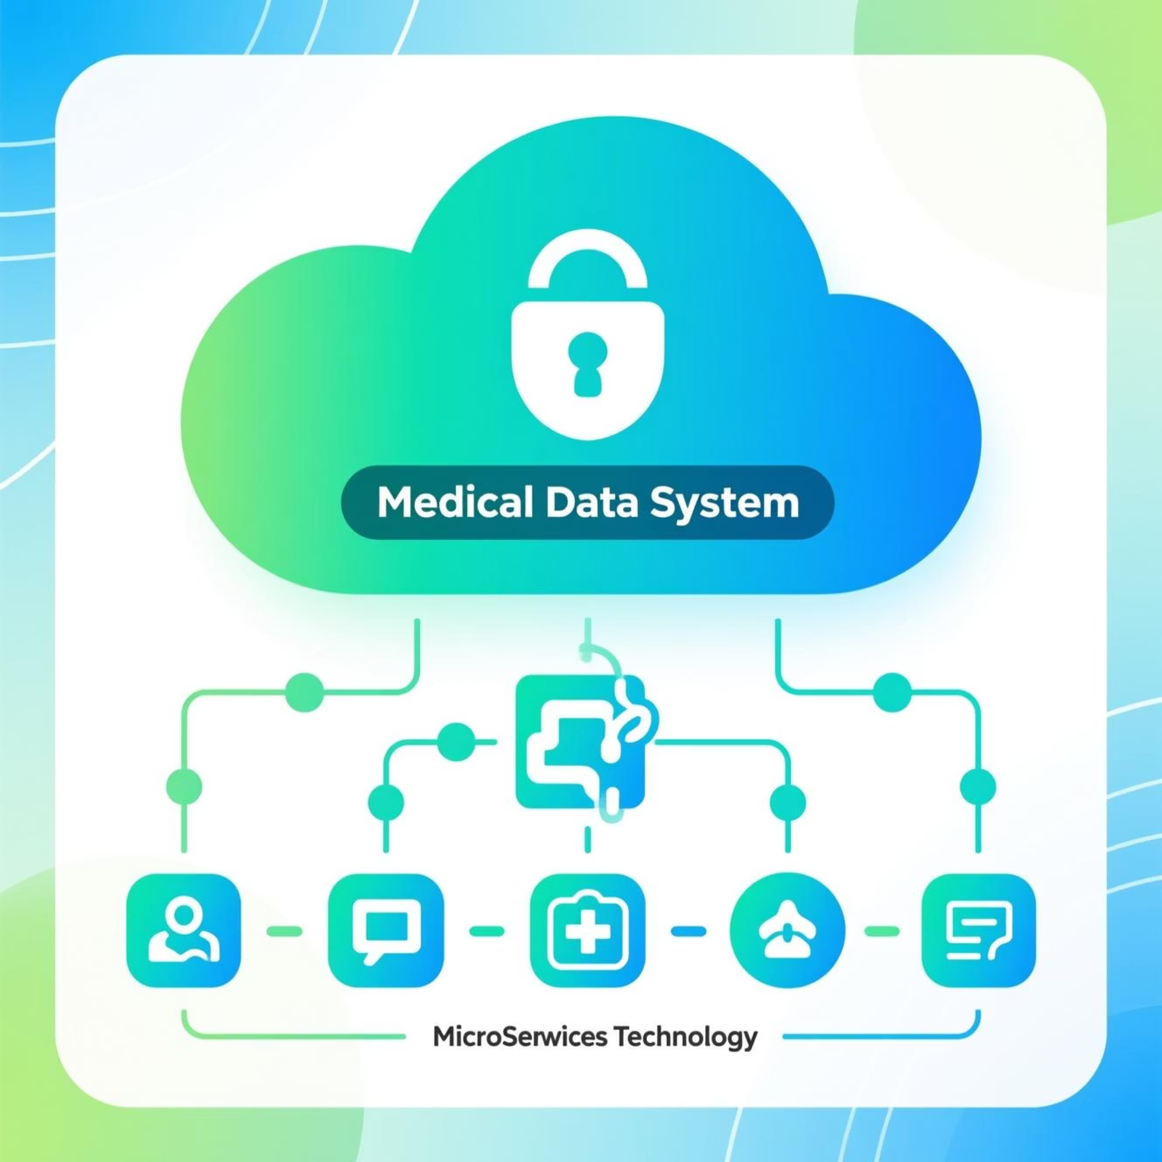

Technical Architecture
System Foundation
Mobile-first architecture
Role-based access control
India-hosted encrypted cloud
Offline-enabled modules
Microservices backend
API-ready for KNRUHS & ABDM
Security First: No patient data in pilot phase
Student
Faculty
Admin
DME

Slide 9
Implementation Plan
10 Days to Launch
Days 1–2
1
Platform setup & department mapping
2
Days 3–4
Student & faculty onboarding
Days 5–7
3
Logbooks, postings, attendance & hostel live
4
Days 8–9
AI learning & dashboards activation
Day 10
5
Review + readiness confirmation
💰 Budget Components
Tablets
(Available on demand)
Hosting & servers
Deployment team
Support & maintenance

Slide 10

Ready to Transform Medical Education
🎯 Next Steps
📞 Contact
🚀 Timeline
Schedule pilot kickoff meeting
TechM4India – TechM4Solutions Division
Launch in 10 days
Let's make GMC Kothagudem Telangana's first fully digital medical campus

